Slide 1
Advanced Computer Vision Chapter 9
Image Stitching
Presented by 張蓉蓉 and 傅楸善教授
E-mail: r07922152@ntu.edu.tw

Slide 2
Outline
9.1 Motion Models
9.2 Global Alignment
9.3 Compositing

Slide 3
Image Mosaics
+ + … + =
Goal: Stitch together several images into a seamless composite

Slide 4
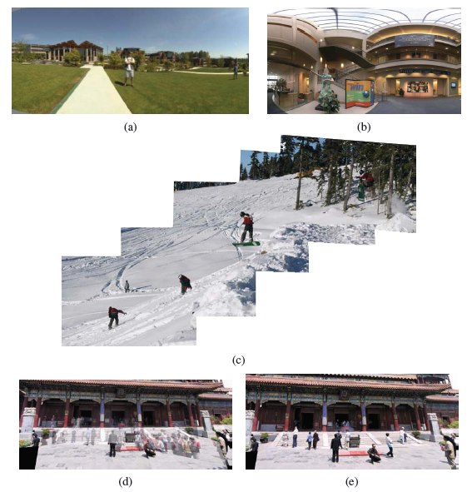
Figure 9.1 Image stitching: (a) portion of a cylindrical panorama and (b) a spherical panorama constructed from 54 photographs (Szeliski and Shum 1997) c 1997 ACM; (c) a multi-image panorama automatically assembled from an unordered photo collection; a multi-image stitch (d) without and (e) with moving object removal (Uyttendaele, Eden, and Szeliski 2001) c 2001 IEEE.

Slide 5
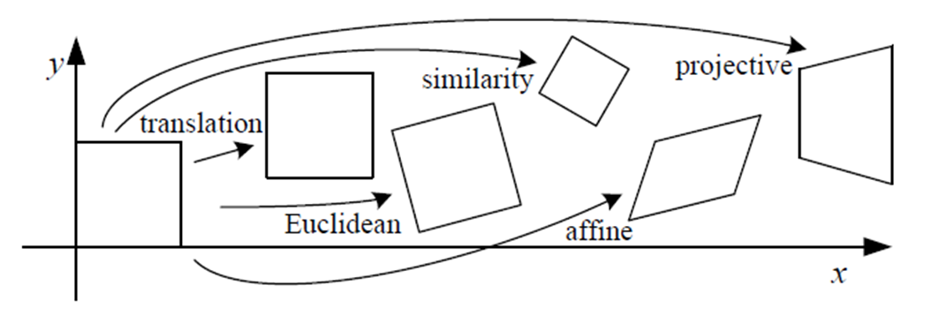
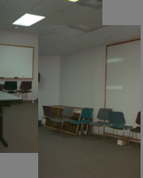
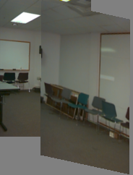
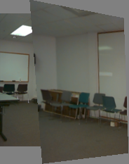
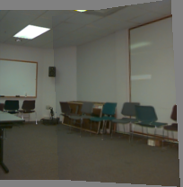
9.1.1 Planar Perspective Motion
Translation
Affine
Perspective
3D rotation
2 degree
6 degree
8 degree
3 degree

Slide 6
9.1.2 Application: Whiteboard and Document Scanning
The simplest image-stitching application is to stitch together a number of image scans taken on a flatbed scanner.
One complication is that a 2D rigid transformation is non-linear in the rotation angle.
A bigger problem lies in the pairwise alignment process. As you align more and more pairs, the solution may drift so that it is no longer globally consistent.
Problem: drift
Notes:
匹配的特征點增多，解的值會產生漂移。

Slide 7
Problem: Drift
copy of first image
Solution
add another copy of first image at the end
this gives a constraint: y_{n} = y₁
there are a bunch of ways to solve this problem
add displacement of (y₁ – y_{n})/(n -1) to each image after the first
compute a global warp: y’ = y + ax
run a big optimization problem, incorporating this constraint

Slide 8
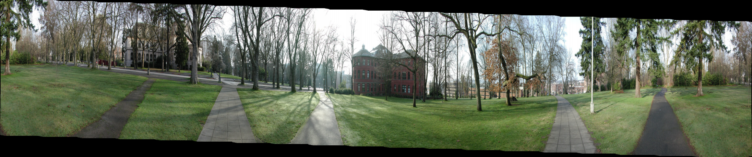
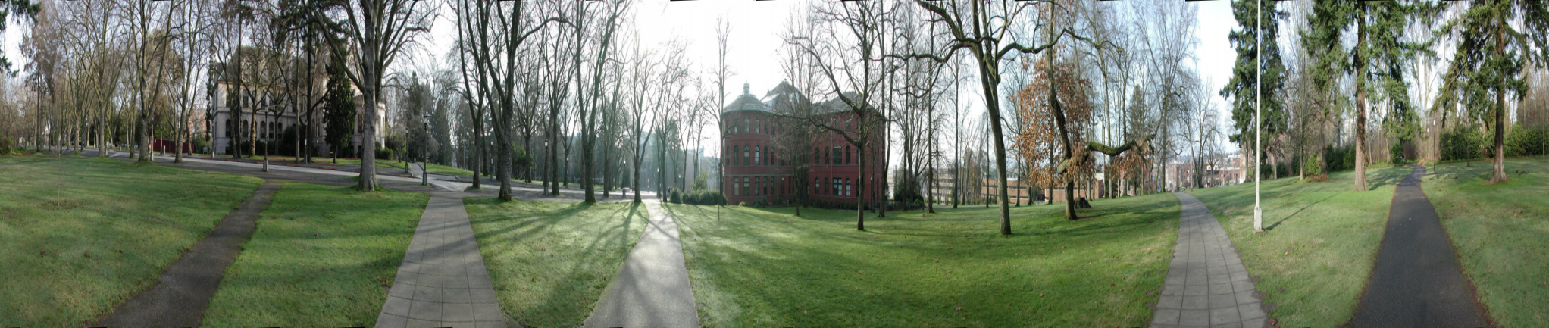

Slide 9
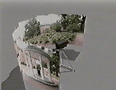
9.1.3 Rotational Panoramas
The most typical case for panoramic image stitching is when the camera undergoes a pure rotation.
http://graphics.stanford.edu/courses/cs178/applets/projection.html
Notes:
相機沒有產生位移，就沒有深度變化。深度變化：離相機近的物體運動比較快，物體之間的位置關係產生了變化。

Slide 10
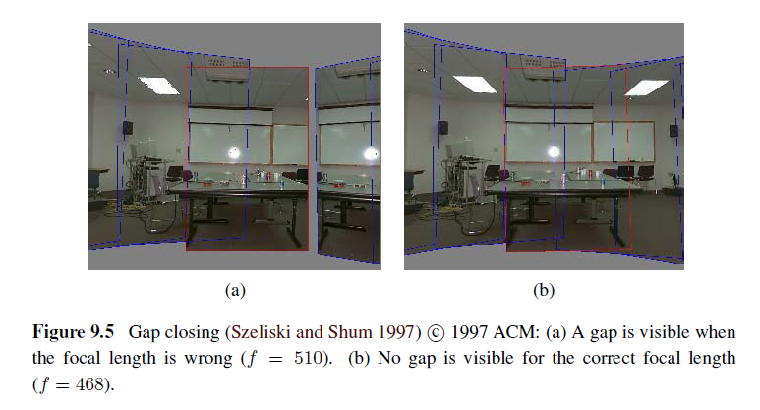
9.1.4 Gap Closing
Notes:
在拍旋轉全景圖時，3D旋轉運動模型的參數會受焦距影響，所以對焦距的估計不準確，造成誤差累積，會產生無法閉合的情況

Slide 11
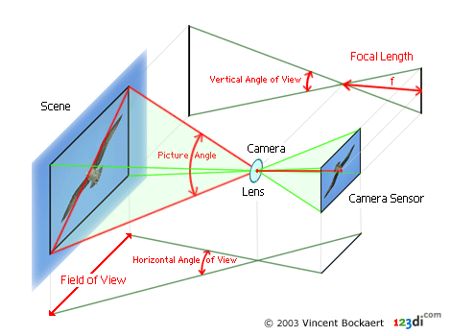
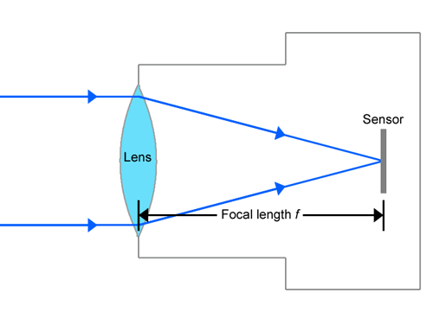
Focal Length
The focal length of a lens is the distance from the image plane to the lens.

Slide 12
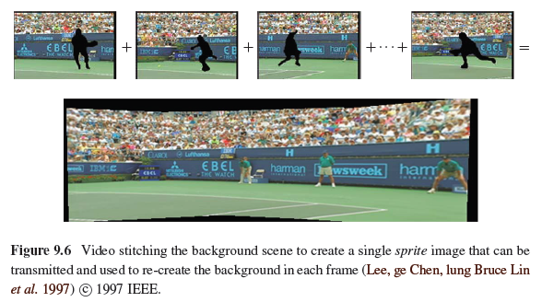
9.1.5 Application: Video Compression

Slide 13
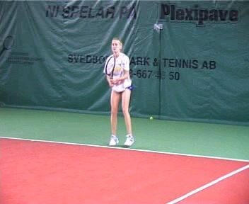
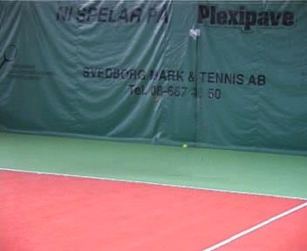
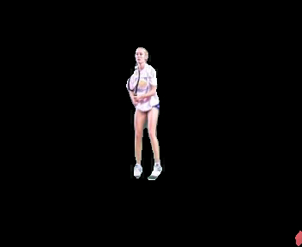
9.1.5 Application: Video Compression
=
+
Input
Segmentation result
Result by: L.Zelnik-Manor, M.Irani
“Multi-frame estimation of planar motion”, PAMI 2000

Slide 14
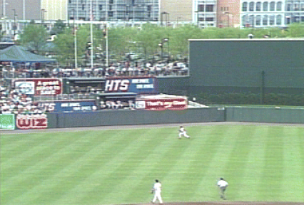
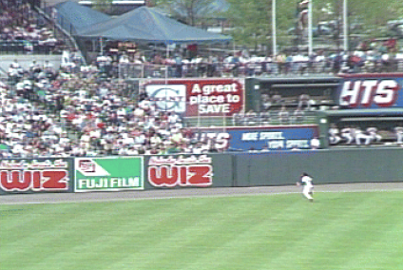
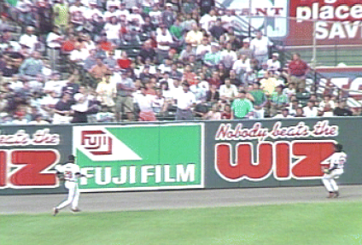
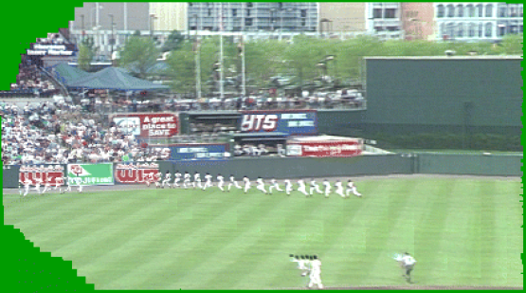
Video summarization
9.1.5 Application: Video Summarization

Slide 15
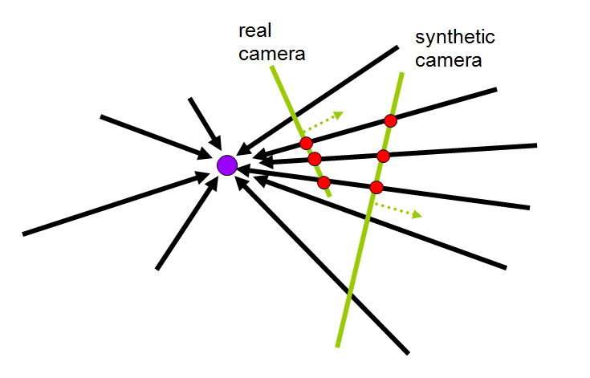
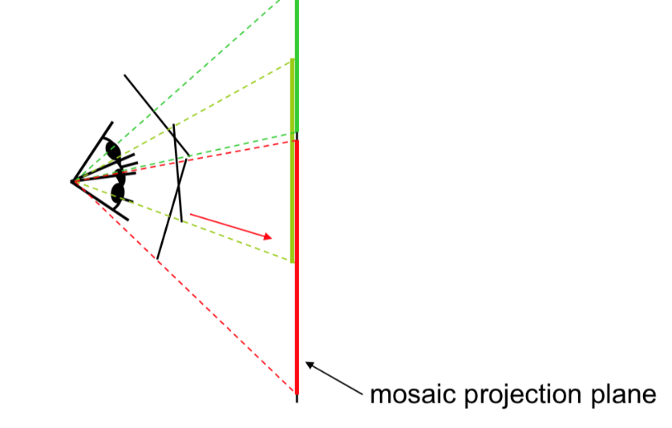
9.1.6 Cylindrical and Spherical Coordinates
An alternative to using homographies or 3D motions to align images is to first warp the images into cylindrical coordinates and then use a pure translational model to align them.

Slide 16
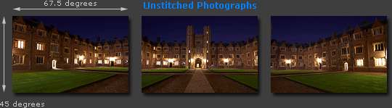
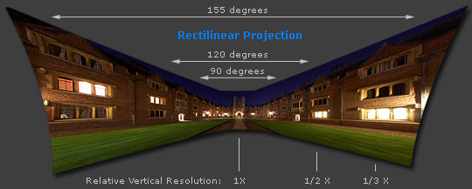
Cylindrical projection
Adopted from http://www.cambridgeincolour.com/tutorials/image-projections.htm
Notes:
http://www.cambridgeincolour.com/tutorials/image-projections.htm

Slide 17
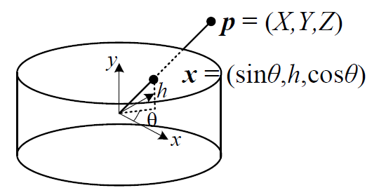
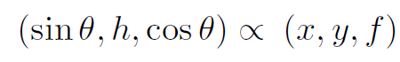
9.1.6 Cylindrical and Spherical Coordinates
We wish to project this image onto a cylindrical surface of unit radius.
Points on this surface are parameterized by an angle and a height h, with the 3D cylindrical coordinates corresponding to (θ,h) given by:
f: focal length

Slide 18
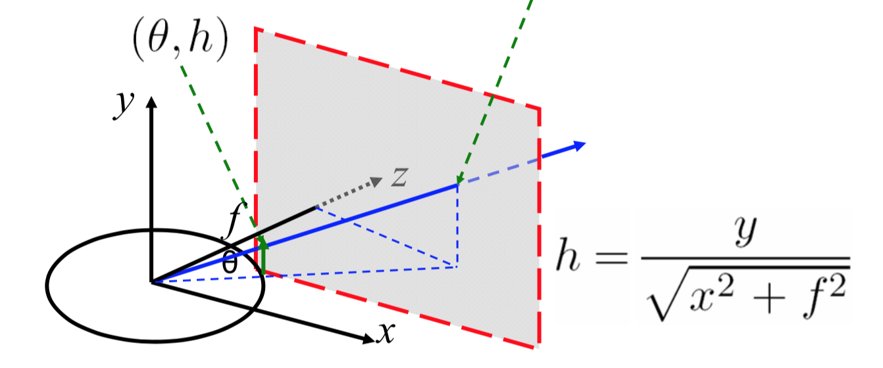
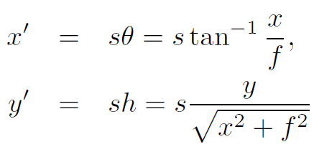
9.1.6 Cylindrical and Spherical Coordinates
s is an arbitrary scaling factor (sometimes called the radius of the cylinder)
We can set s = f to minimize the distortion (scaling) near the center of the image.

Slide 19
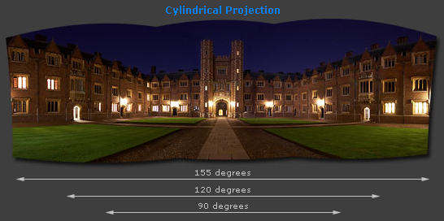
Cylindrical projection
Adopted from http://www.cambridgeincolour.com/tutorials/image-projections.htm
Notes:
http://www.cambridgeincolour.com/tutorials/image-projections.htm

Slide 20
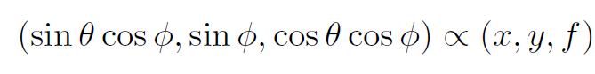
9.1.6 Cylindrical and Spherical Coordinates
Images can also be projected onto a spherical surface, which is useful if the final panorama includes a full sphere or hemisphere of views, instead of just a cylindrical strip.
In this case, the sphere is parameterized by two angles (θ,ϕ), with 3D spherical coordinates given by:

Slide 21
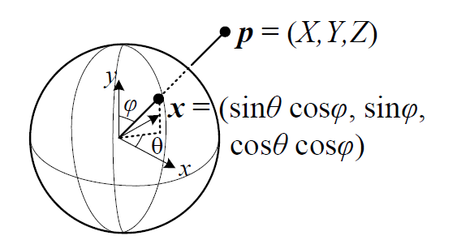
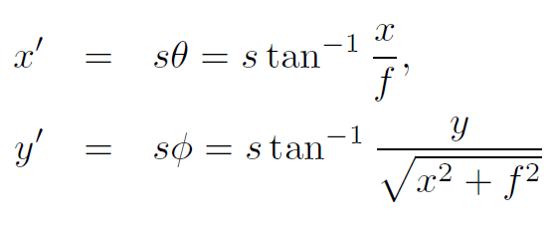
9.1.6 Cylindrical and Spherical Coordinates
The correspondence between coordinates is now given by:
Notes:
Theta 投影到XOZ平面和z軸的夾角 Phi 和XOZ平面的夾角

Slide 22
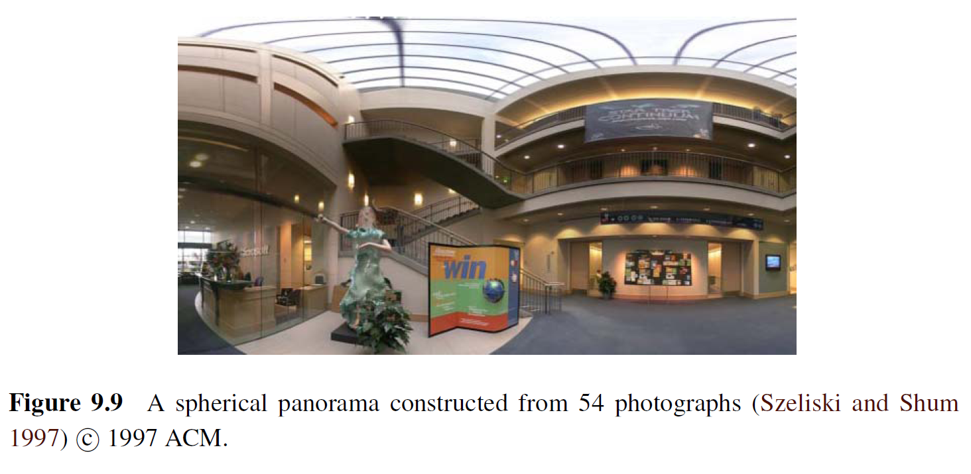
9.1.6 Cylindrical and Spherical Coordinates
https://www.youtube.com/watch?v=m9pbCzUPmY8

Slide 23
9.2 Global Alignment
In this section, we extend the pair wise matching criteria to a global energy function that involves all of the per-image pose parameters.
Once we have computed the global alignment, we often need to perform local adjustments, such as parallax removal, to reduce double images and blurring due to local mis-registrations.

Slide 24
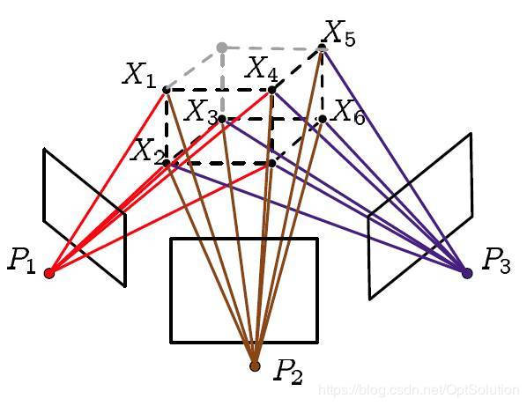
9.2.1 Bundle Adjustment
The process of simultaneously adjusting pose parameters for a large collection of overlapping images is called bundle adjustment in the photogrammetry community.
Notes:
利用多張影像上的匹配的特征點對進行三角定位，通過計算來估計這些特征點的三維坐標和相機的參數矩陣。用估計的三維坐標和參數矩陣對所有影像做一次投影，希望重建的這個投影和真實的在影像平面上的投影的差值最小。解一個最優化問題，用最小平方法去迭代求解。

Slide 25
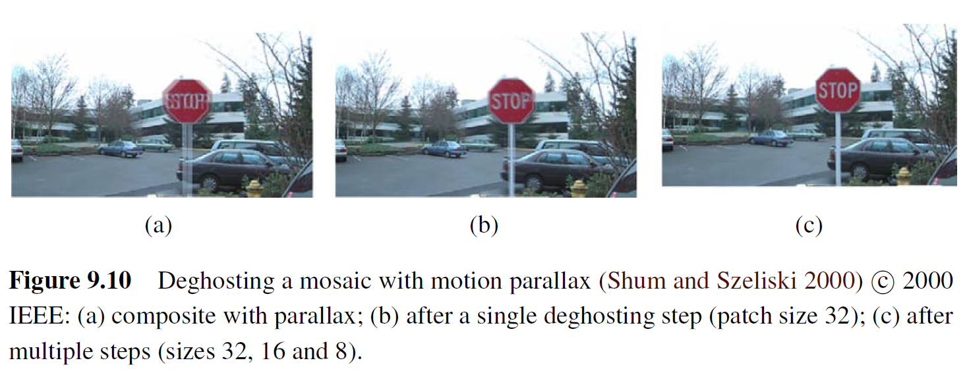
9.2.2 Parallax Removal

Slide 26
9.2.2 Parallax Removal
The resulting stitched image sometimes looks blurry or ghosted in some places.
This can be caused by:
A unmodeled radial distortion
3D parallax (failure to rotate the camera around its optical center)
Small scene motions such as waving tree branches
Large-scale scene motions such as people moving in and out of pictures

Slide 27
9.2.2 Parallax Removal
Radial distortion
Plumb-line method
3D parallax
A full 3D bundle adjustment
Small scene motions
optical flow can be used to perform an appropriate correction before blending using a process called local alignment
Large-scale scene motions
simply select pixels from only one image at a time

Slide 28
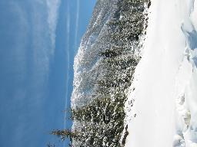
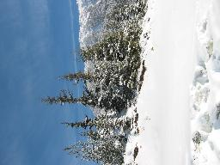
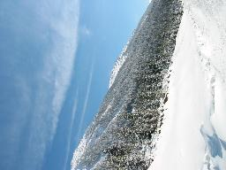
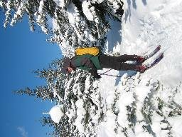
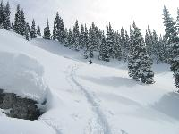
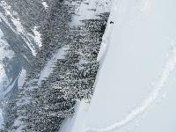
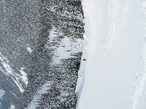
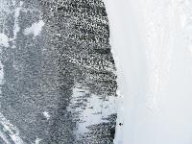
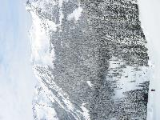
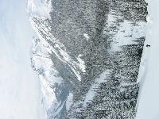
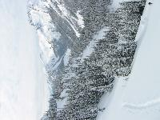
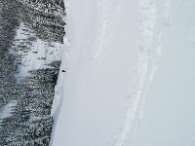
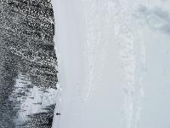
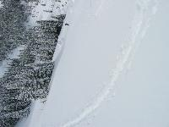
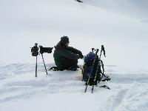













9.2.3 Recognizing panoramas

Slide 29
9.2.3 Recognizing panoramas
Feature detection and description (SIFT)
Fast matching (hash table)
RANSAC filtering of matches
Intensity-based verification
Incremental bundle adjustment
[M. Brown, R. Szeliski, and S. Winder. Multi-image matching using multi-scale oriented patches, CVPR'2005]
SIFT: scale invariant feature transform
Notes:
Intensity-based，SIFT雖然穩定，但可能有出錯的時候，如果SIFT把影像對齊正確，影像重疊部分的亮度也應該要相近

Slide 30





SIFT
Notes:
每個octave是同一尺度，各octave的同一層形成了 Gaussian Pyramid
找極大值是在同一尺度下。每個尺度都有每個尺度的特征點，所以縮放不變
旋轉主方向（旋轉不變），生成描述子，歸一化處理（去除光照影響，亮度不變）
平移: 取局部，所以平移不變
旋轉: 取了角度的histogram後找出最主要的方向()，以該方向為基準，所以旋轉不變
縮放: 因為在不同解析度取共同的feature，所以縮放不變

Slide 31
RANSAC
Run k times:
(1) choose n samples randomly
(2) fit parameters H with these n samples
(3) for each of other N-n points, calculate its
distance to the fitted model, count the
number of inliers points, c
n : smaller is better

Slide 32
9.2.3 Recognizing panoramas

Slide 33
9.2.3 Recognizing panoramas

Slide 34
9.2.3 Recognizing panoramas

Slide 35
9.2.3 Recognizing panoramas

Slide 36
9.2.4 Direct vs. feature-based alignment
Early feature-based methods
The features get confused in regions that were either too textured or not textured enough
The features be distributed unevenly over the images, thereby failing to match image pairs that should have been aligned.
The features did not work well when the images were rotated or had foreshortening due to homographies.

Slide 37


Harris corner detector
Aperture Problem
Notes:
影像亮度變化或縮小或旋轉，有些feature就消失了

Slide 38
9.2.4 Direct vs. feature-based alignment
Today, feature detection and matching schemes are remarkably robust and can even be used for known object recognition from widely separated views.
Furthermore, because they operate in scale-space and use a dominant orientation (or orientation invariant descriptors), they can match images that differ in scale, orientation, and even foreshortening.

Slide 39
9.3 Compositing
namely compositing surface parameterization
pixel and seam selection
Blending
exposure compensation

Slide 40
9.3.1 Choosing a compositing surface
Flat panorama
If only a few images are stitched together, a natural approach is to select one of the images as the reference and to then warp all of the other images into its reference coordinate system.

Slide 41

9.3.1 Choosing a compositing surface
For larger fields of view, however, we cannot maintain a flat representation without excessively stretching pixels near the border of the image.
The usual choice for compositing larger panoramas is to use a cylindrical or spherical projection

Slide 42
9.3.1 Choosing a compositing surface
View selection
As mentioned above, for a flat composite, we can choose one of the images as a reference.
A reasonable choice is the one that is geometrically most central.

Slide 43
9.3.1 Choosing a compositing surface
Coordinate transformations
The final compositing surface is flat.
The final composite surface has some other analytic form (e.g., cylindrical or spherical).
lookup tables by the partial trigonometric functions
computing exact pixel mappings on a coarser grid and then interpolating these values

Slide 44
9.3.1 Choosing a compositing surface
Sampling issues
If the final panorama has a lower resolution than the input images, pre-filtering the input images is necessary to avoid aliasing.
Under certain conditions, it may also be possible to produce images with a higher resolution than the input images using the process of super-resolution.

Slide 45
9.3.2 Pixel selection and weighting (de-ghosting)
Once the source pixels have been mapped onto the final composite surface, we must still decide how to blend them in order to create an attractive-looking panorama.
visible seams (due to exposure differences)
blurring (due to mis-registration)
ghosting (due to moving objects)

Slide 46

9.3.2 Pixel selection and weighting (de-ghosting)
The simplest way to create a final composite is to simply take an average value at each pixel:
Visible drawback by:
exposure differences
misregistrations
scene movement

Slide 47

Final composites computed by a variety of algorithms (Szeliski 2006a):
(a)average, (b) median, (c) feathered average, (d) p-norm p = 10,
Notes:
Median filter: 快速移動
Feathered average： 曝光差異 P-norm: 距離圖像轉換成更高次冪，讓貢獻大的數值占主導地位 平衡曝光和模糊

Slide 48

(e) Voronoi, (f) weighted ROD vertex cover with feathering, (g) graph cut seams with Poisson blending and (h) with pyramid blending.
Notes:
Voroni: p-norm p->infinite 只選擇權重最大的點，即影像集合中最接近該像素的點 曝光變化大的時候有邊緣和間隙產生 weighted ROD: 建圖，頂點覆蓋演算法，走一條路，走過所有頂點且weight最小。頂點表示重疊部分不一樣的區域，每條邊的weight是不一樣區域的差分值，然後避免走到這些weight poisson blending: gradient domain smoothing 不直接複製像素點，複製新圖片的梯度，複製區域的實際亮度值通過求解泊松方程得到

Slide 49
9.3.3 Application: Photomontage
While image stitching is normally used to composite partially overlapping photographs, it can also be used to composite repeated shots of a scene taken with the aim of obtaining the best possible composition and appearance of each element.

Slide 50



Slide 51

9.3.4 Blending

Slide 52



9.3.4 Blending
+
1
=
1
0
0

Slide 53
Image Feathering
Weight each image proportional to its distance from the edge (distance map [Danielsson, CVGIP 1980]
Generate weight map for each image
Sum up all of the weights and divide by sum: weights sum up to 1:
w_{i}’ = w_{i} / ( ∑_{i} w_{i})

Slide 54
Image feathering
Weight each image proportional to its distance from the edge (distance map [Danielsson, CVGIP 1980]
1. Generate weight map for each image
2. Sum up all of the weights and divide by sum: weights sum up to 1: w_{i}’ = w_{i} / ( ∑_{i} w_{i})

Slide 55



Image Feathering

Slide 56


Effect of window size
1
left
1
right
0
0

Slide 57


Effect of window size
1
1
0
0

Slide 58

Good window size
1
0
“Optimal” window: smooth but not ghosted
Doesn’t always work...

Slide 59



Pyramid Blending
Burt, P. J. and Adelson, E. H., A multiresolution spline with applications to image mosaics, ACM Transactions on Graphics, 42(4), October 1983, 217-236.

Slide 60

Gaussian Pyramid
G₀=I
G₁=Down(G₀∗F)
G₂=Down(G₁∗F)
⋅⋅⋅
G_{N-1}=Down(G_{N−2}∗F)
G_{N}=Down(G_{N−1}∗F)
Laplace Pyramid
L₀=G₀−Up(G₁∗F)
L₁=G₁−Up(G₂∗F)
L₂=G₂−Up(G₃∗F)
⋅⋅⋅
L_{N−1}=G_{N−1}−Up(G_{N}∗F)
L_{N}=G_{N}
Level N
Reconstruction
G_{N−1}≈L_{N−1}+Up(L_{N})
G_{N−2}≈L_{N−2}+Up(G_{N−1})
⋅⋅⋅
G₁≈L₁+Up(G₂)
G₀≈L₀+Up(G₁)
Level 0

Slide 61

Notes:
http://graphics.cs.cmu.edu/courses/15-463/2005_fall/www/Lectures/Pyramids.pdf
1.Load the two images of apple and orange
2.Find the Gaussian Pyramids for apple and orange (in this particular example, number of levels is 6)
3.From Gaussian Pyramids, find their Laplacian Pyramids
4.Now join the left half of apple and right half of orange in each levels of Laplacian Pyramids
5.Finally from this joint image pyramids, reconstruct the original image.

